Slide 1

Avalanche
A journal that writes to you
By: Cédric, Nawaf, Sahij, & Moveen

Slide 2
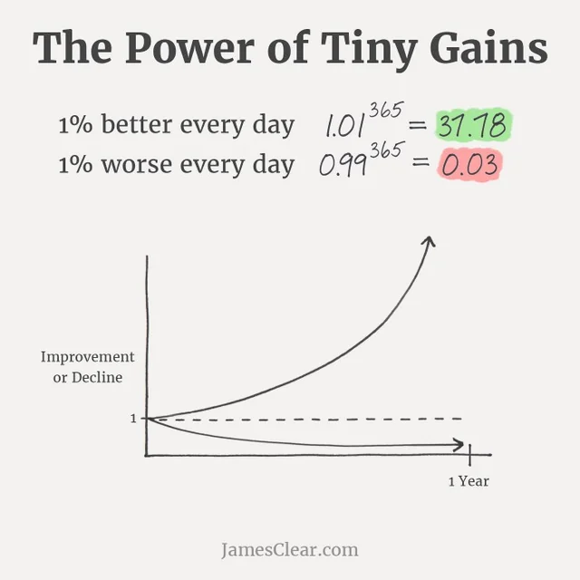
WHAT IS AVALANCHE?
AI-integrated journal that provides its users with personalized advice
Learns about the user’s habits and goals to gain an understanding of the user
By giving small-scale advice consistently, we can realistically help the user reach their goal
Improving 1% everyday leads to 37x improvement over the span of a whole year

Slide 3

IMPACT // SOCIAL GOOD
We can use this app to help people achieve their goals systematically
This new AI based journaling can help people better track their progress
We hope to help people guide themselves to change their behaviour gradually to change themselves into who ever they want to be...
We want to show people they can do anything given proper guidance

Slide 4
DEMO // FEATURES
Login/signup system for unique users
Creates a profile of the user:
2 journal entries per day (plan & reflection) using text-to-speech for ease of use
Onboarding page that asks for goals, hobbies, occupation
Curates small-scale advice daily based on the user’s profile using Llama
Chat history preserved for future viewability

Slide 5
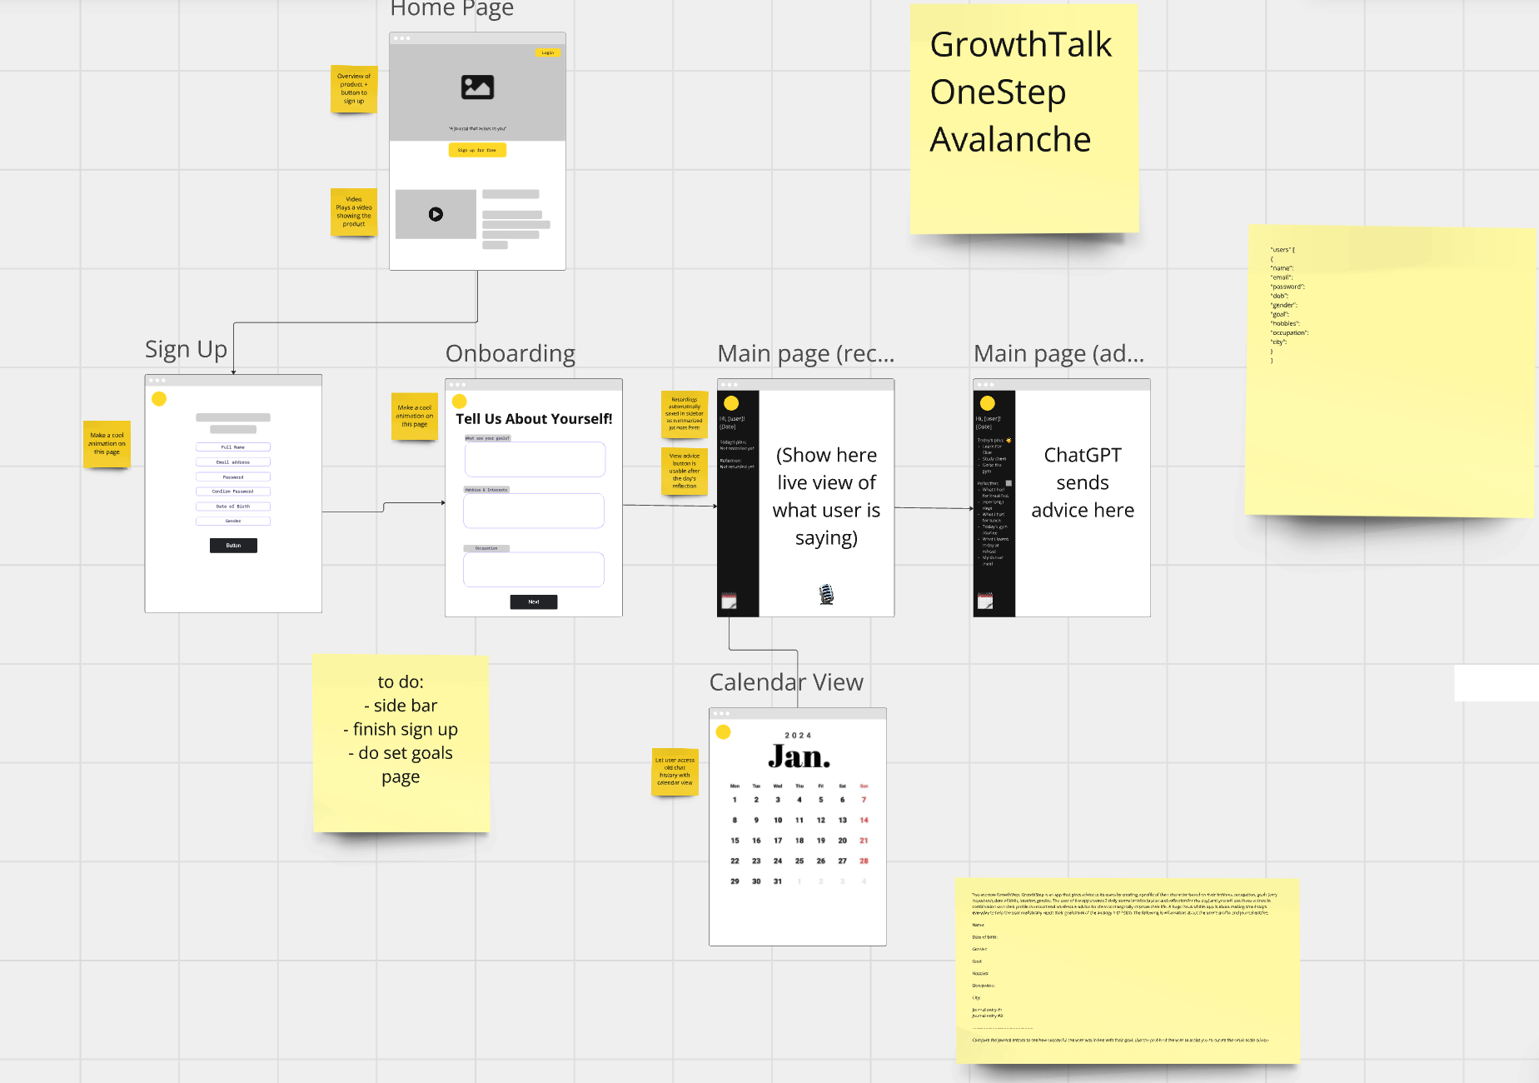
LEARNING // ROADBLOCKS
New skills gained:
Product planning
Working with AI
Learnt how to use Git
Roadblocks:
Data parsing from AI
Creating layout for the website
https://miro.com/app/board/uXjVLZ40fNw=/

Slide 6
THANKS! Any questions?

